Slide 1



Escrow Payments Industry: Competitive Landscape and Market Dynamics
Group Members
Edeh Mary
Nwachukwu Zinachidi
Gabadeen Labeebah
Emenyonu Ezinne

Slide 2
CONTENTS
1. Introduction
2. Market Overview
3. Competitor Landscape
4. Market Trends
5. Customer Insights
6. Strategic Recommendations
7. Opportunities and Challenges
8. Conclusion

Slide 3
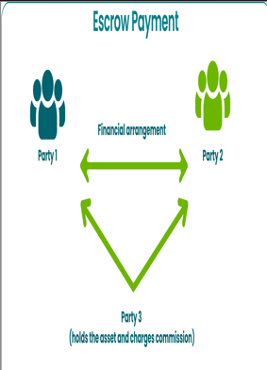
Introduction
Escrow payment services act as a trusted third party to hold funds until all terms of a transaction are met.
They are widely used in high-value transactions such as real estate, online marketplaces, freelance contracts, and mergers & acquisitions.
The role of escrow services is crucial in preventing fraud, ensuring compliance, and building trust between buyers and sellers.

Slide 4

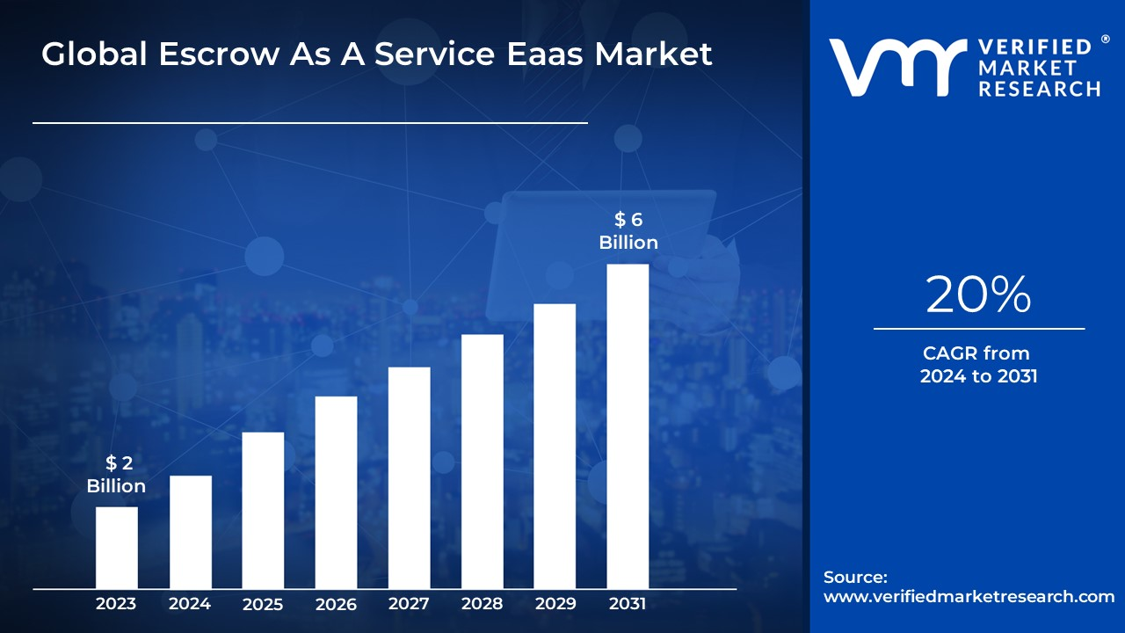
Market Overview
Current market size and projected growth.
Key drivers fueling market expansion.
.
Rise in Digital Transactions
Cybersecurity Concerns
Regulatory Compliance
2024 Market Value: $2.4 billion
Projected 2033 Value: $17.91 billion

Slide 5
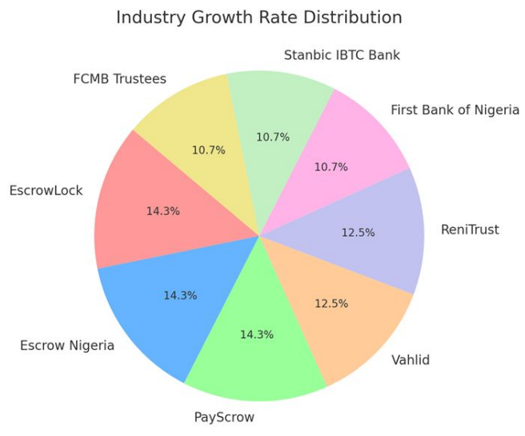
Competitor Landscape
Company | Products/Services | Pricing Model | Strengths | Weaknesses
Escrow.com | AI-powered escrow for real estate, e-commerce, and B2B transactions | Tiered pricing (starting at 1.5% per transaction) | Secure transactions, Flexible payment Methods | Higher fees for premium services, Not Available in Nigeria.
Payscrow | Escrow for online marketplaces, freelance payments, and business transactions | Flat 2% transaction fee (2% of the transaction amount plus ₦100) | Seamless escrow for e-commerce and freelancers, API Integration. | Limited enterprise solutions, Additional Fixed fee.
EsccrowLock | General Merchandise Escrow, Services Escrow, Real Estate Transactions | Custom pricing based on transaction value. Standard, reduced/minimum fee | Strong international presence, diverse payment options | Less user-friendly interface, Market Awareness.

Slide 6

Market Trends
Escrow as a Service (EaaS) – Increasing demand for integrated escrow solutions, allowing businesses to embed escrow functionality into their platforms for seamless transactions.
Cryptocurrency Integration – More platforms are adopting crypto-based escrow services to facilitate secure and decentralized transactions, especially in high-value and international deals.
Regulatory Compliance Growth – Stricter financial regulations globally are driving the adoption of escrow services to ensure transaction security and prevent fraud.
Mobile-First Demand – Users prefer mobile-friendly escrow platforms, prompting companies to enhance mobile usability and app-based escrow services.

Slide 7

Strategic Recommendations
Develop a Mobile-First Strategy – Enhance mobile usability to attract digital-first users.
Expand into Emerging Markets – Target regions with rising online transactions.
Integrate Cryptocurrency Support – Tap into the growing crypto payment ecosystem.
Enhance Transparency & Security – Strengthen fraud prevention measures.
Leverage Partnerships – Collaborate with e-commerce and B2B platforms for adoption.

Slide 8
Challenges
High Competition – Many players offering similar services.
Regulatory Barriers – Compliance with multiple financial regulations.
User Trust Issues – Need for secure, transparent escrow transactions.
Limited Awareness – Many businesses unaware of escrow service benefits.

Slide 9

Conclusion
.
The Escrow Payments industry is growing rapidly, driven by digital transactions and security needs. Competitors are diversifying, but gaps exist in mobile experience and transparency. The comparison of Escrow.com, PayScrow, and EscrowLock highlights the diverse approaches and competitive advantages each provider offers. The escrow market in Nigeria is ripe for disruption —whoever provides the most seamless, mobile-friendly, low-cost solution will dominate the market.

Slide 10
Thank You

